Slide 1

The final report of the project entitled
H.R. RECRUITMENT APPLICATION
Submitted in the partial fulfillment of the requirements for the degree of
BACHELOR’S OF TECHNOLOGY
IN
COMPUTER SCIENCE AND ENGINEERING
Batch (2015-2019)
SUPERVISED BY:
Er. Hardeep Singh(Guide)
Er. Tarandeep singh(Co-Guide)
SUBMITTED BY:
Rishab Sood
2015CSA1617
B.Tech (CSE) 8th SEM

Slide 2
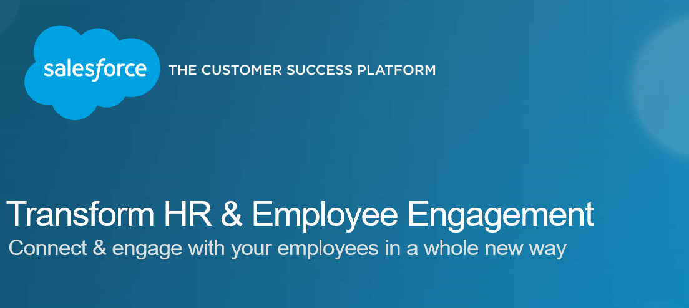
HR RECRUITMENT APPLICATION

Slide 3
INTRODUCTION TO ORGANIZATION
Sebiz Infotech,Mohali gave me this wonderful opportunity to learn Salesforce in their premises.
Sebiz is having a parent IT company named as ‘Netsmartz’.
It is fast gaining a reputation for high quality training in the Northern Region. It was set up with the goal of making fresh graduates industry-ready with highly focused programs and emphasis on lab work rather than practical. Today SFS has widened its repertoire to include Industrial Training, Online Courses and Weekend Workshops for corporates and working professionals.

Slide 4
INTRODUCTION TO SALESFORCE
Salesforce is a leading CRM (Customer Relationship Management) software which is served form cloud. It has more than 800 applications to support various features like generating new leads, acquiring new leads, increasing sales and closing the deals. It is designed to manage the organization's data focused on customer and sales details. It also offers features to customize its inbuilt data structures and GUI to suit the specific needs of a business. More recently, it has started offering the IOT (internet of things) connectivity to the CRM platform.
Salesforce delivers a highly customized experience to the customers, employees, and partners of an organization. Such a platform is used to customize standard functionality and create custom pages, components, apps, etc. Also it is done faster, mainly because of the superb architecture on which it is built. Below is a brief introduction to the Salesforce Architecture.

Slide 5
BENEFITS OF SALESFORCE
Reliable.
Many tiers of security.
24/7 Availability.
Automation of everyday tasks.
Provides CRM for enhanced communication
Improves efficiency and proficiency.

Slide 6
PROBLEMS WITH EXISTING SYSTEM
The HR usually make a list of shortlisted candidates manually with either excel spreadsheets or word.
Moreover , Present system do not automate the processes.
Hr’s have to contact to employment websites through telephonic calls or e-mails.
Hr’s find it complex to make a list of potential candidates.

Slide 7
Objectives of the project
HR Recruiting App intends to reduce the hectic job of recruiting the employees manually.
Company can instantaneously upload vacancies using this app notifying the potential employees.
The Recruiting app make sure that a new job opening has executive approval before it becomes active.
Include reports that give users an overview of recruiting status.
Allow recruiters to map the locations of all candidates who are applying for a position, to better understand relocation expenses.
Make it easy to perform several similar tasks at once, like rejecting multiple job applications.
Automatically post open positions on Universal Containers' public website.

Slide 8
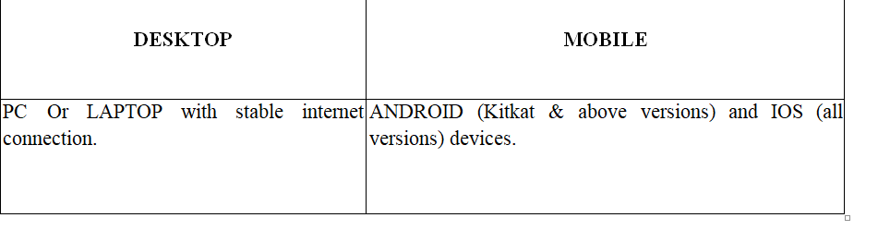
Hardware Requirements

Slide 9
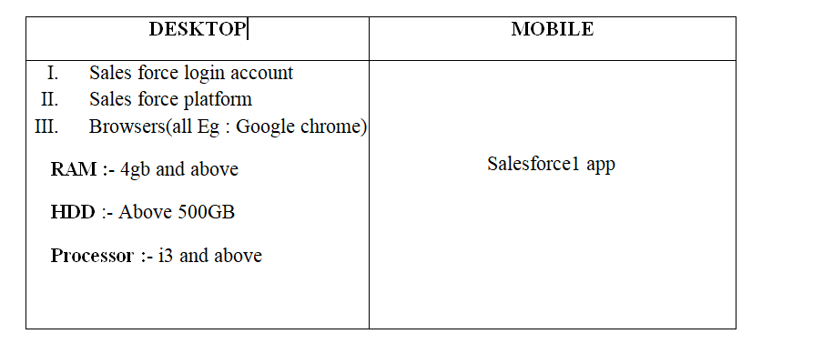
Software Requirements

Slide 10
Architectural Design
There are 2 types of objects in Salesforce: Custom Objects and Standard Objects.
Custom Objects are those objects which are made by the user itself where a while Standard objects are those which are provided by default by the Salesforce

Slide 11
Modules In The App
Custom Modules
Position Module
Candidate Module
Job Application Module
Job Posting Module
Employment Website Module
Interviewer Module
Standard Modules
Account Module
Users Module
Reports and Dashboards Module

Slide 12
Relation Design
There are 2 types of Relationship in Salesforce: Master-Detail and Look-up Relationship.
In Master-Detail Relationship , we have one parent object and multiple child objects.
In Lookup Relationship, this is one more category of one-to-many relationship but two objects will not put any effect on deletion or security.

Slide 13
ENTITY RELATIONSHIP DIAGRAM

Slide 14
Functional Design
The functional design phase provides a translation between the requirements analysis and the detail design.
In a software development project, the functional design focuses on the general definition of the whole system or application.
Commonly, the functional design is confused with a technical design.

Slide 15
Functional design shown in the form of Data Flow Diagrams

Slide 16
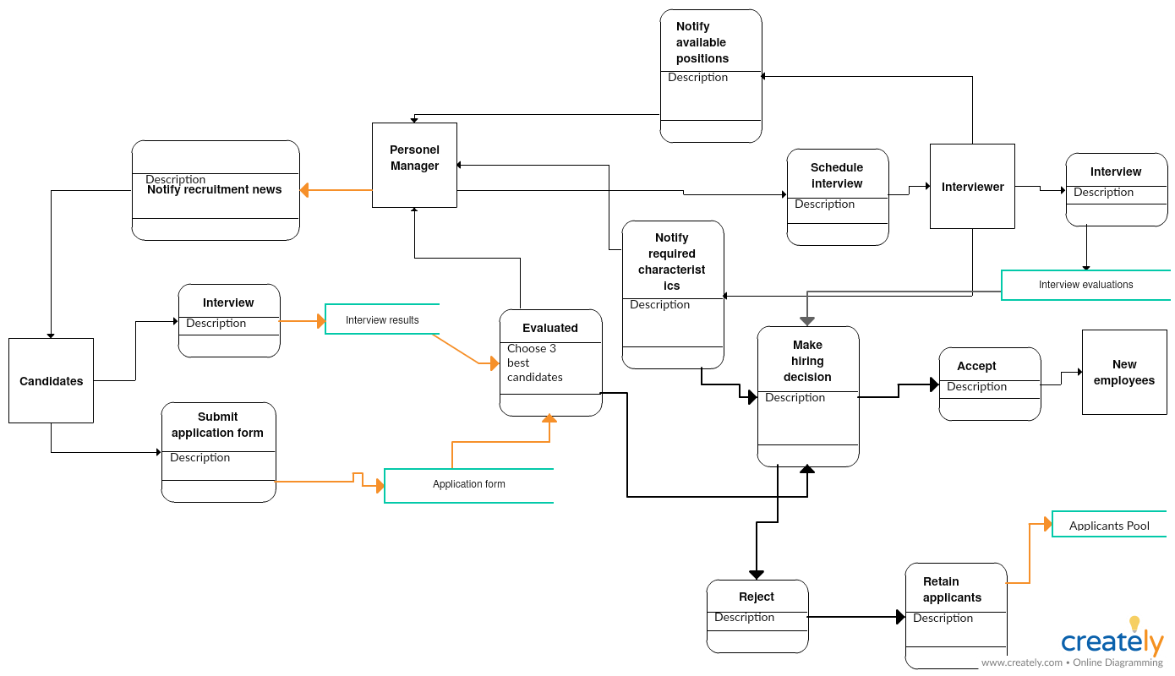
DETAILED DATA FLOW DIAGRAM

Slide 17
Implementation
Implementation includes
Screenshots of project
Working of project
Various Modules in project

Slide 18
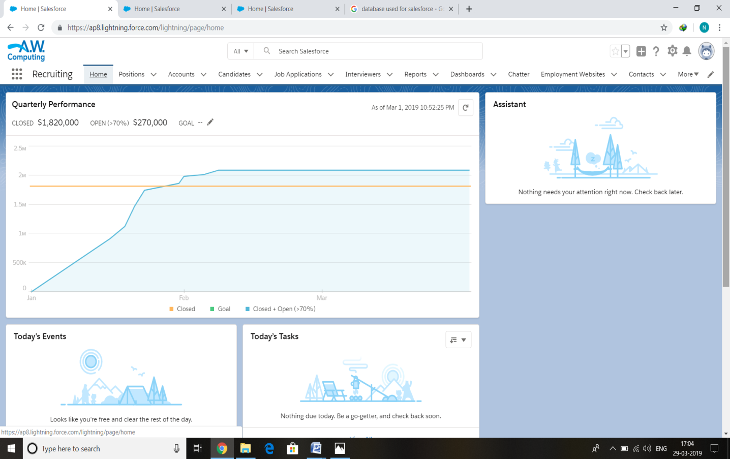
Home Page
Home page showing various modules and tabs in project

Slide 19
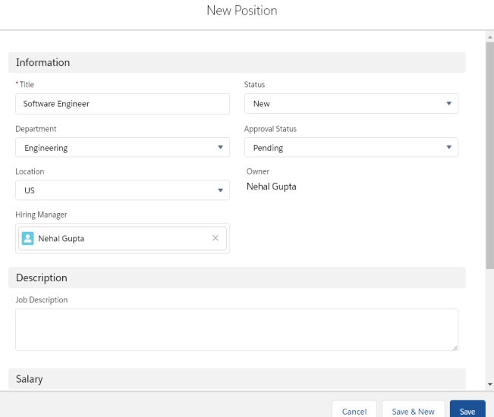
Adding a new position

Slide 20
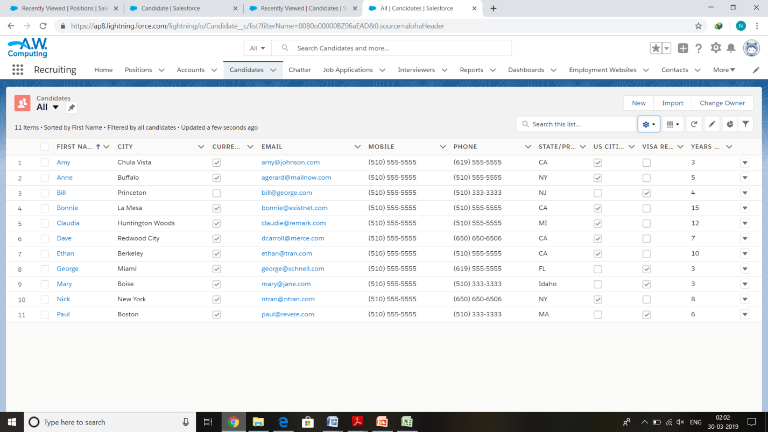
Available Candidates

Slide 21
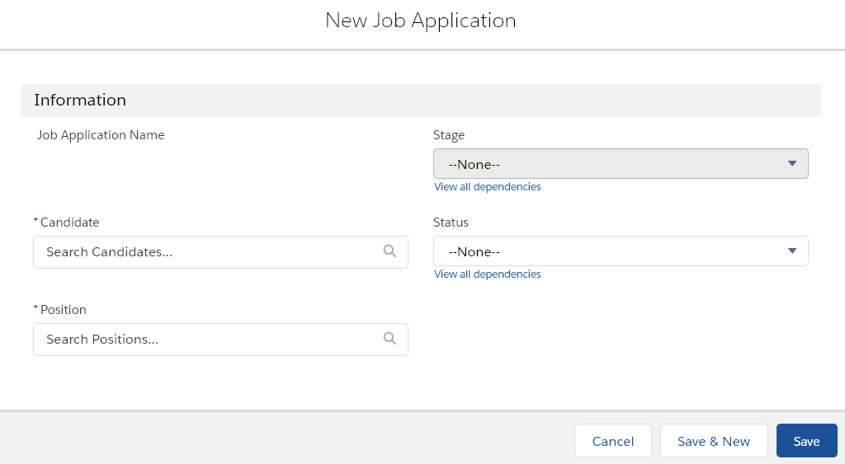
Job Applications

Slide 22
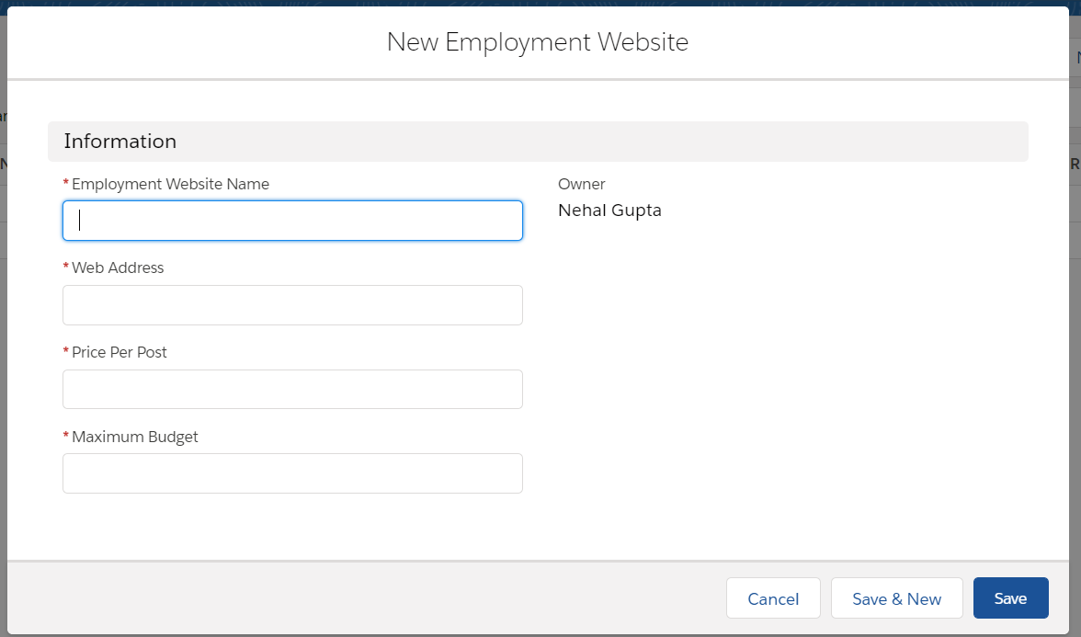
Employment Websites

Slide 23
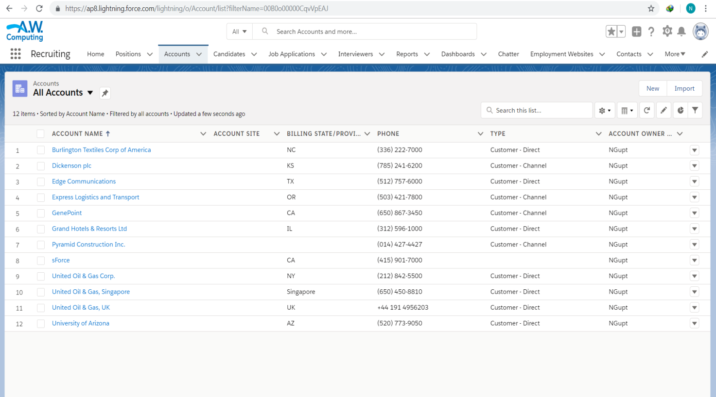
Accounts

Slide 24
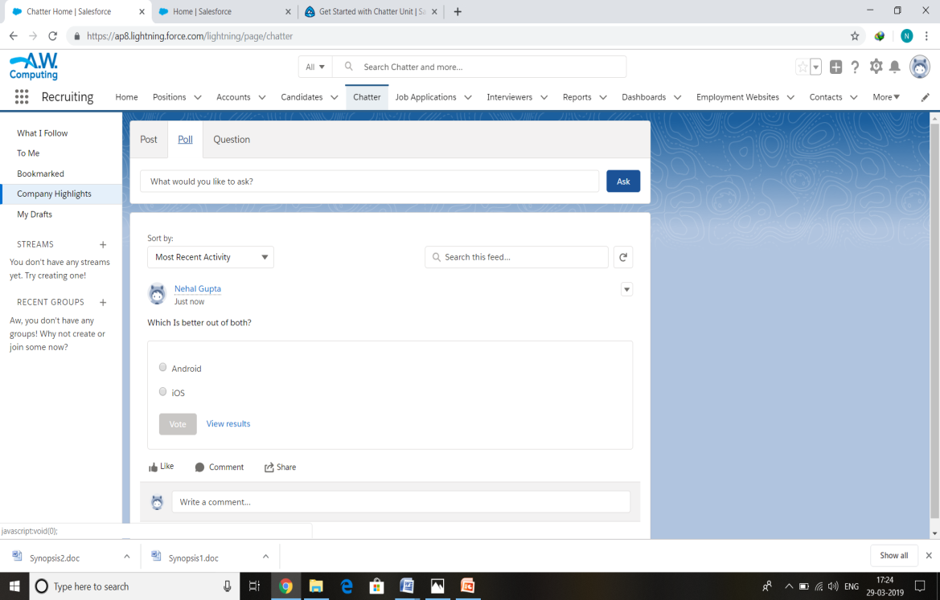
Chatter

Slide 25
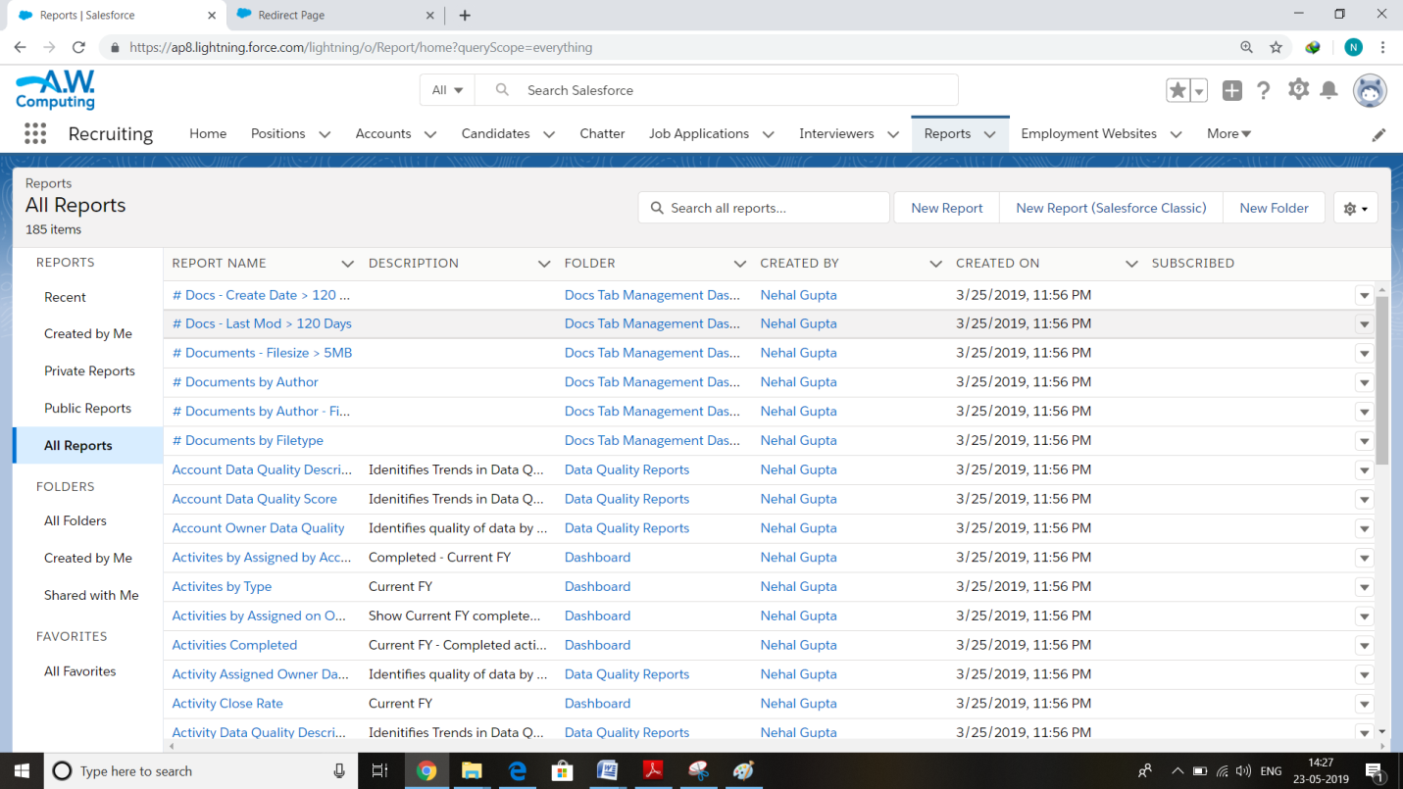
Reports

Slide 26
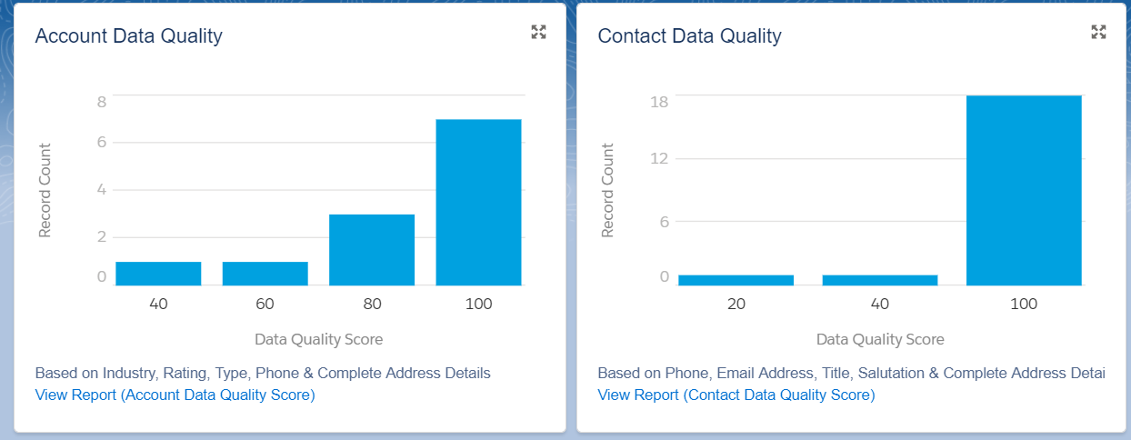
Dashboards

Slide 27
Merits
Morale and motivation of employees improves.
Promotes loyalty and commitment amongst employees due to sense of job security and advancements.
Chances of proper selection high.
Present employees familiar with organization surroundings.
Time and expenditure for recruitment reduced.

Slide 28
Conclusion
In a bid to underscore this subtle point, the project examines the various processes and nuances of the most critical activities of an organization.

Slide 29
THANK YOU!

